Slide 1
Chapter 2. Fundamental Concepts
2.1 Time Series and Stochastic Processes
2.2 Means, Variances, and Covariances
2.3 Stationarity

Slide 2
2.1 Time Series and Stochastic Processes
Definition
The sequence of random variables
{Y_{t}: t = 0, ±1, ±2, ± 3, …}
is called a stochastic process.

Slide 3
2.2 Means, Variances and Covariances
Definition
For a stochastic process {Y_{t}: t = 0, ±1, ±2, ±3, …},
the mean function is defined by
the autocovariance function, γ_{t,s}, is defined as
where
Cov(Y_{t}, Y_{s}) = E[(Y_{t} – μ_{t})(Y_{s} – μ_{s})] = E(Y_{t} Y_{s}) – μ_{t} μ_{s}.

Slide 4
2.2 Means, Variances and Covariances
Definition
the autocorrelation function, ρ_{t,s}, is defined as
where

Slide 5
2.2 Means, Variances and Covariances
Remark
Follow from the known results in variance and covariance, we obtain
When the values of ρ_{t,s} near ±1 indicate strong linear dependence, whereas values near zero indicate weak linear dependence. If ρ_{t,s} = 0, we say that Y_{t} and Y_{s} are uncorrelated.

Slide 6
2.2 Means, Variances and Covariances
If c₁, c₂, …, c_{m} and d₁, d₂, …, d_{n} are constants and t₁, t₂, …, t_{m} and s₁, s₂, …, s_{n} are time points, then
What is the relation between Corr(a + bX, c + dY) and Corr(X, Y)?

Slide 7
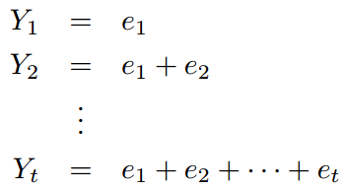
2.2 Means, Variances and Covariances
The Random Walk
Let e₁, e₂, … be a sequence of independent, identically distributed (i.i.d.) random variables each with zero mean and variance .
The observed time series, {Y_{t}, t = 1, 2, …}, is constructed as follows:

Slide 8

2.2 Means, Variances and Covariances
Alternatively, we can write
If the e’s are interpreted as the sizes of the “steps” taken (forward or backward) along a number line, then Y_{t} is the position of the “random walker” at time t.

Slide 9
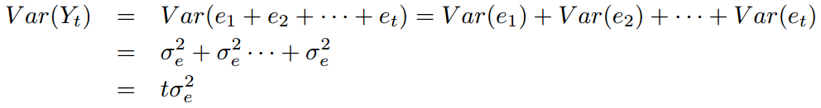
2.2 Means, Variances and Covariances
Properties of the random walk:
The mean function μ_{t} = 0 for all t. (Verify it!)
The process variance increases linearly with time.

Slide 10
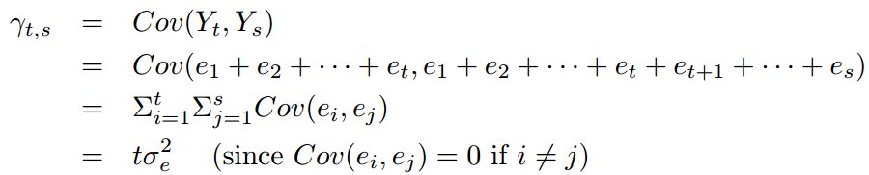
2.2 Means, Variances and Covariances
Suppose that 1 ≤ t ≤ s, the autocovariance function is given by

Slide 11
2.2 Means, Variances and Covariances
The autocorrelation function is obtained as
We see that the values of Y at neighboring time points are more and more strongly and positively correlated as time goes by. On the other hand, the values of Y at distant time points are less and less correlated.

Slide 12
2.2 Means, Variances and Covariances
A simulated random walk is shown in the Exhibit 2.1 where e’s were selected from a standard normal distribution.
Note that even though the theoretical mean function is 0 for all time points, the fact that the variance increases over time and that the correlation between process values nearby in time is nearly 1 indicate that we should expect long excursions of the process away from the mean level of zero.
The random walk process provides a good model (at least of a first approximation) for the movement of stock price.

Slide 13
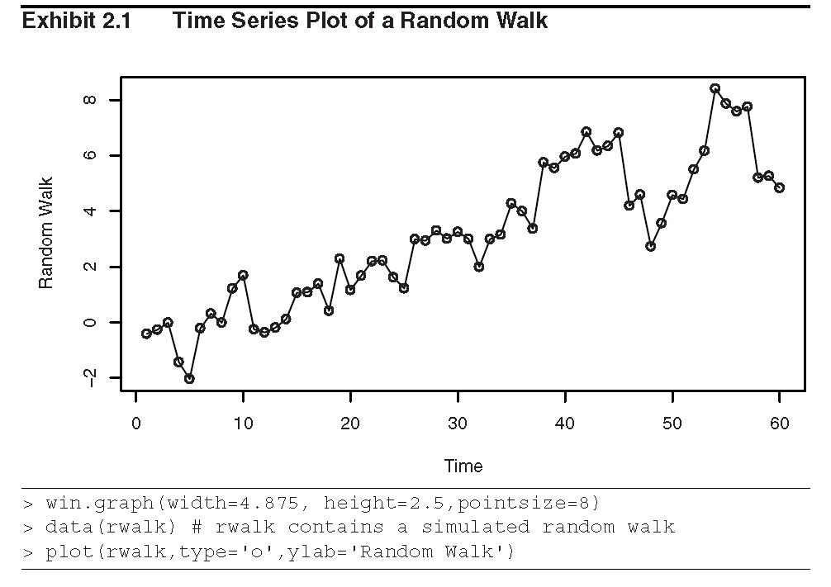

Slide 14
2.2 Means, Variances and Covariances
A Moving Average
The observed time series, {Y_{t}, t = 1, 2, …}, is constructed as:
where e₁, e₂, … is a sequence of i.i.d. random variables each with zero mean and variance .
Properties of the moving average:
The mean function μ_{t} = 0 for all t.
The process variance is given by .
(Exercise: Verify (a) and (b).)

Slide 15
2.2 Means, Variances and Covariances
The autocovariance function is given by.
Proof
When t = s or |t – s| = 0, γ_{t,t} = Var(Y_{t}).
For the case of |t – s| = 1, consider

Slide 16
2.2 Means, Variances and Covariances
Since γ_{t,s} = γ_{s,t} , we obtain .

Slide 17
2.2 Means, Variances and Covariances
For the case of |t – s| > 1, for k > 1, consider
♦

Slide 18
2.2 Means, Variances and Covariances
From (b) and (c), the autocorrelation function is given by.
Notice that, ρ_{t, t–k} is the same for all values of t.

Slide 19
2.3 Stationarity
Definition
A process {Y_{t}} is said to be strictly stationary if the joint distribution of Y_{t1}, Y_{t2}, …, Y_{tn} is the same as the joint distribution of Y_{t1− k} , Y_{t2− k} , …, Y_{tn− k} for all choices of time points t₁, t₂, …, t_{n} and all choices of time lag k.
Properties of the strictly stationary process:
When n = 1, the distribution of Y_{t} is the same as that of Y_{t – k} for all t and k. It follows that the mean function E(Y_{t}) and variance function Var(Y_{t}) are both constant over time.

Slide 20
2.3 Stationarity
When n = 2, the bivariate distribution of Y_{t} and Y_{s} must be the same as that of Y_{t – k} and Y_{s – k}. It follows that
Putting k = s and then k = t, we obtain
That is, the covariance between Y_{t} and Y_{s} depends on time only through the time difference |t – s| and not otherwise on the actual times t and s.

Slide 21
2.3 Stationarity
Because of the above properties of the stationary process, the notations of the autocovariance and autocorrelation functions can be simplified as
Also,

Slide 22
2.3 Stationarity
Definition
A stochastic process {Y_{t}} is said to be weakly (or second order) stationary if
The mean function is constant over time, and
γ_{t, t – k} = γ_{0, k} for all time t and lag k
In this course, the term “stationary” when used alone will always refer to the weakly stationary.
However, if the joint distributions for the process are all multivariate normal distributions, it can be shown that two definitions coincide.
For stationary processes, we usually only consider k ≥ 0.

Slide 23
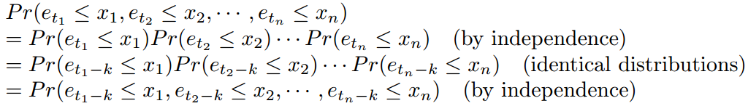
2.3 Stationarity
White Noise
A white noise process is defined as a sequence of independent, identically distributed random variables {e_{t}}.
Properties of the white noise:
The white noise process is a strictly stationary process.
Proof

Slide 24
2.3 Stationarity
The mean function and autocorrelation function of the white noise process are
We usually assume that the white noise process has μ_{t} = 0 for all t and Var(e_{t}) = .
Many useful processes can be constructed from white noise. For example, moving average process and random walk process. We can see that the moving average is a stationary process but not the case for the random walk.

Slide 25
Summary
Mean, autocovariance, and autocorrelation
Stationarity
  Strict stationarity: joint distribution is the same
  Weak stationarity
    Mean function is constant over time
    γ_{t, t – k} = γ_{0, k} for all time t and lag k

Slide 26
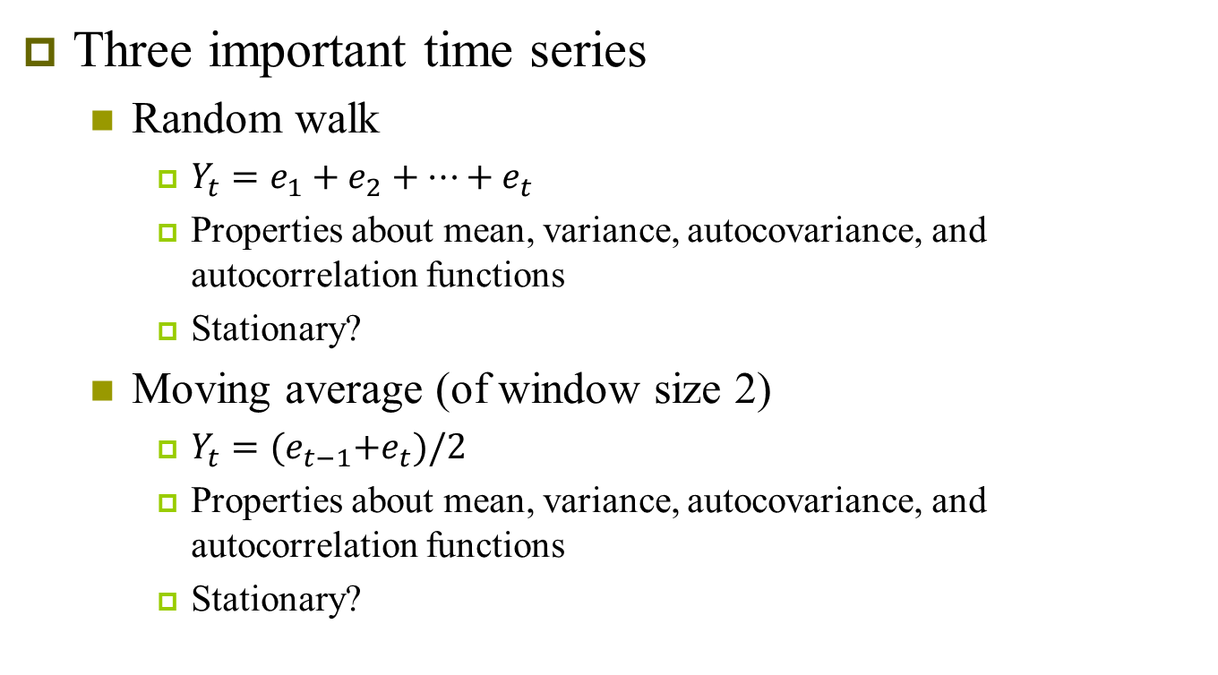
Summary
Three important time series
  Random walk
    $Y_{t}=e_{1}+e_{2}+…+e_{t}$
    Properties about mean, variance, autocovariance, and autocorrelation functions
    Stationary?
  Moving average (of window size 2)
    $Y_{t}={(e}_{t−1}+e_{t})/2$
    Properties about mean, variance, autocovariance, and autocorrelation functions
    Stationary?

Slide 27
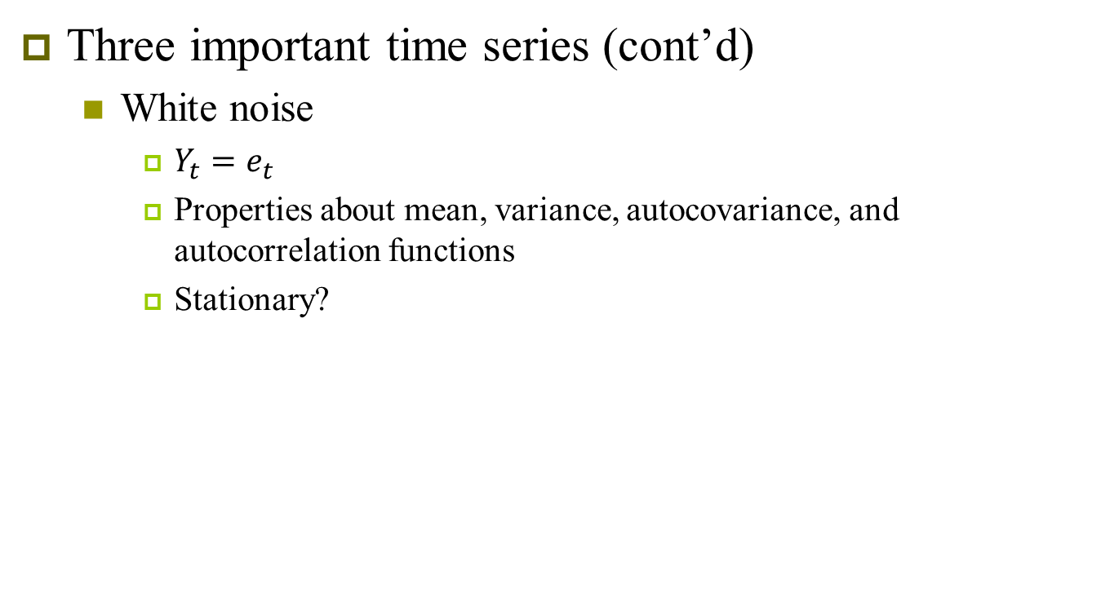
Summary
Three important time series (cont’d)
  White noise
    $Y_{t}=e_{t}$
    Properties about mean, variance, autocovariance, and autocorrelation functions
    Stationary?

